Slide 1

Smart parking assistant
FYP – Dept. Of Software Engineering

Slide 2

Presented by
Saif Akhter- BSE 183038
Mohammad Abdul Rafay – BSE 183009

Slide 3
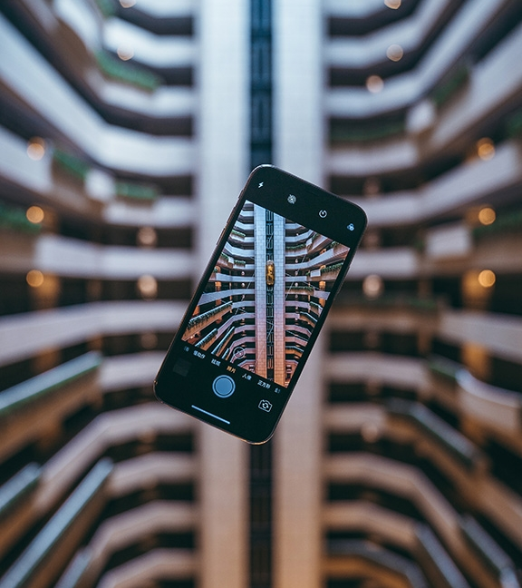
Table of contents
Introduction
Basis
Documentation
Hardware used
Software used
Deployment

Slide 4
Introduction
Smart Parking Assistant – What is it ?
This Smart Parking Assistant project, developed by our group, is the solution designed, keeping in mind the consistently growing populous and hassle of everyday traffic, to counter the difficulties that people face due to these reasons.
The SPA – web based application is a java integrated, easy to use, extensible application with the primary purpose of easing the task of parking in a controlled space with options of reserving a parking spot and viewing available parking spots in live time.

Slide 5

Basis
IOT Based System
The Smart Parking Assistant system is primarily an IOT based system which is based upon some very popular pre-existing systems around the world such as ParkWiz, ParkHero, BestParking.
This system is for a specifically targeted customer spectrum, which includes controlled parking spaces, such as for a university, a hotel, a resort, a mall or an office. The users of the system need to be pre-registered and have active accounts, and be logged in to use the system.

Slide 6
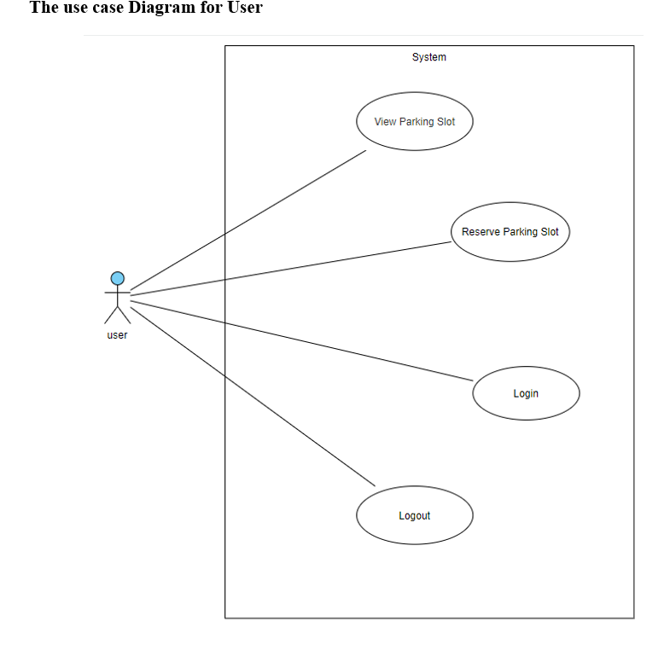
Documentation

Slide 7
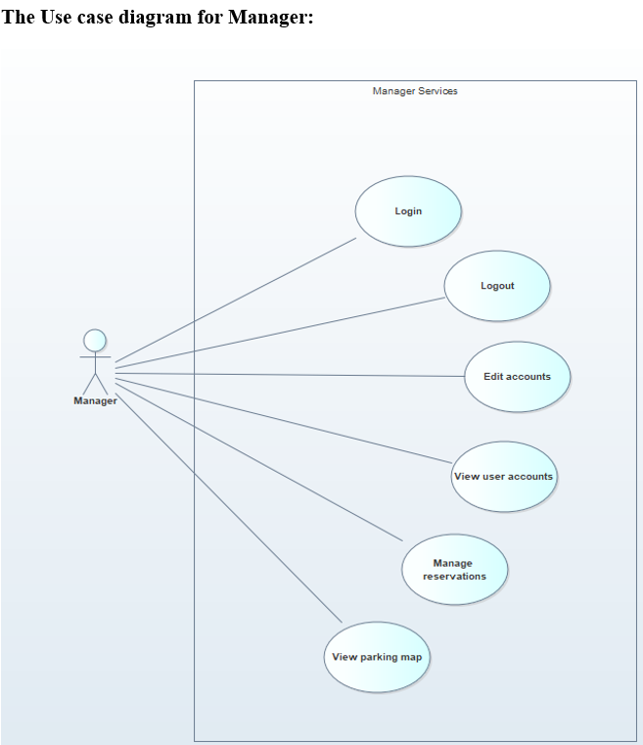
Documentation

Slide 8
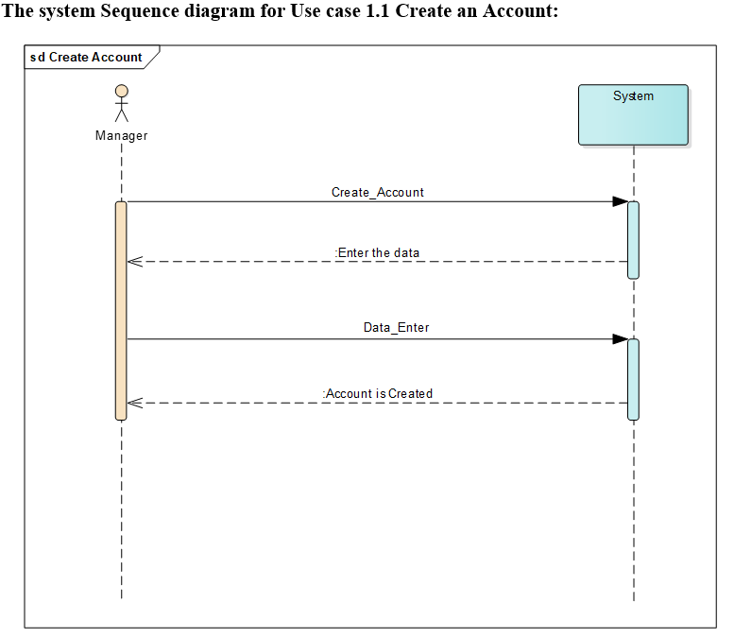
Documentation

Slide 9
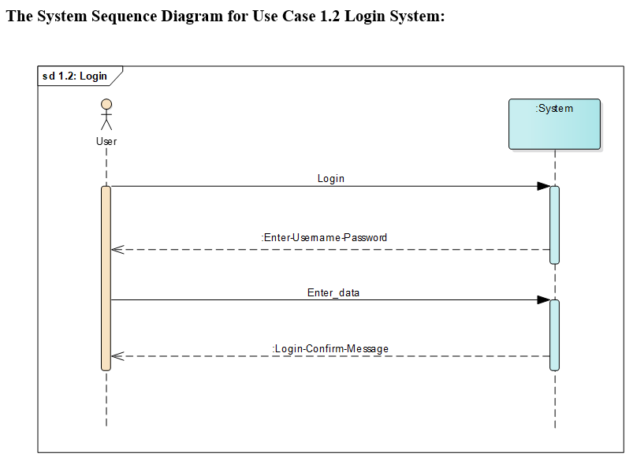
Documentation

Slide 10
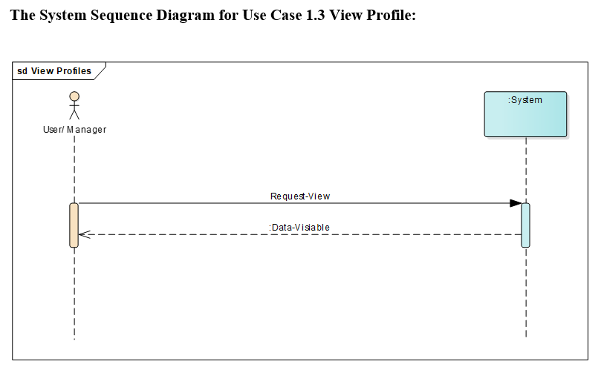
Documentation

Slide 11
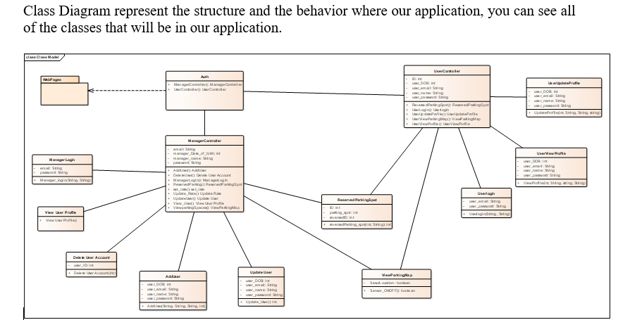
Documentation

Slide 12
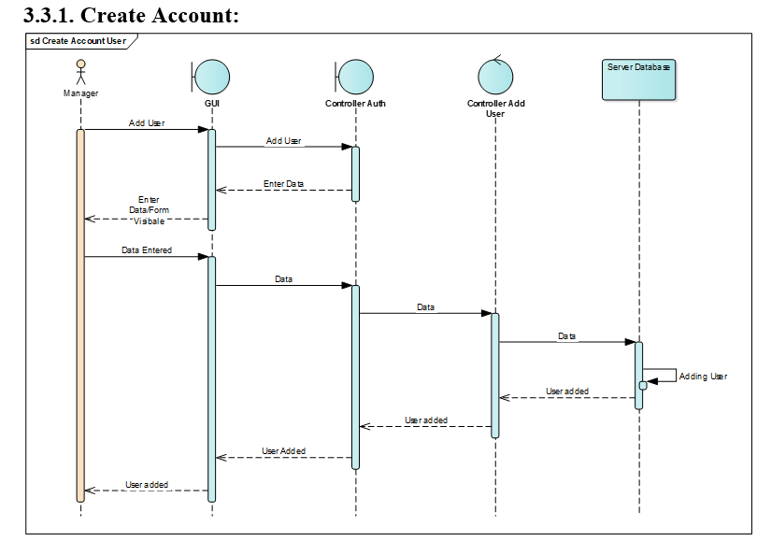
Documentation

Slide 13
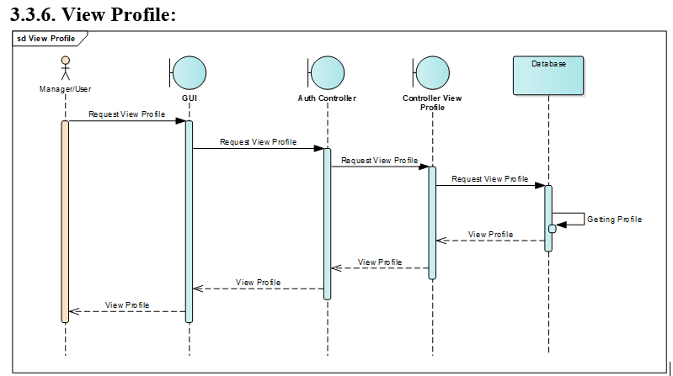
Documentation

Slide 14
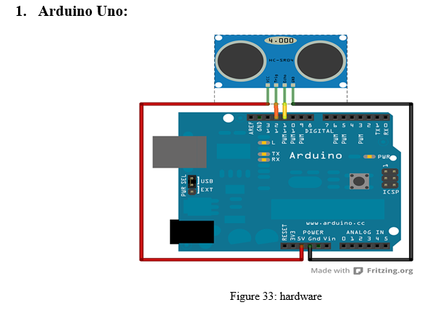
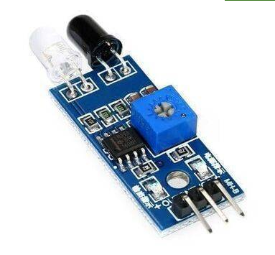
Hardware used
2. IR sensor

Slide 15
Hardware used
The system works via sensors connected to an open-source microcontroller board (Arduino Uno) based on the Microchip ATmega328P microcontroller and developed by Arduino.cc
The sensors work independently, signaling the microcontroller about which spots are vacant and which are occupied. This is further enhanced through the software developed specifically for this system which enables a wider variety of options and optics.

Slide 16
Software Used
The system is pre-dominantly based on Java/Javascrip and is web-based, requiring a url to be opened via any browser. The following languages are also used;
SQL
HTML
CSS
Javascript
The primary purpose of the software is to create a user friendly experience and to provide the customer with all of the handy features that he/she might need for their parking dilemma.

Slide 17

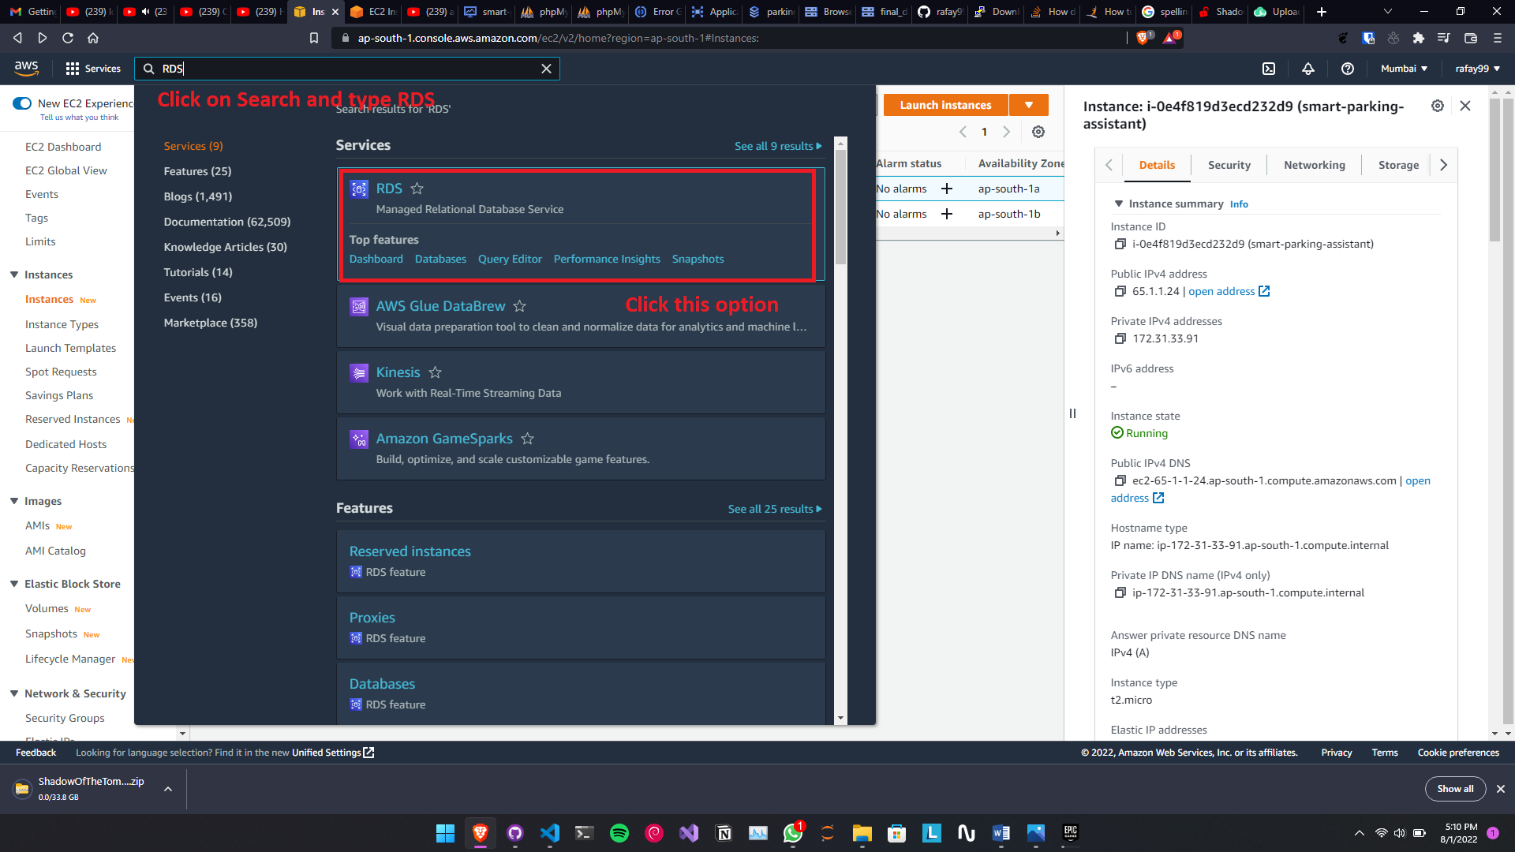
Deployment (Database)
Using the service of AWS database was uploaded and connected to the application and then the application was deployed. The steps to deploy the application is stated bellow.

Slide 18
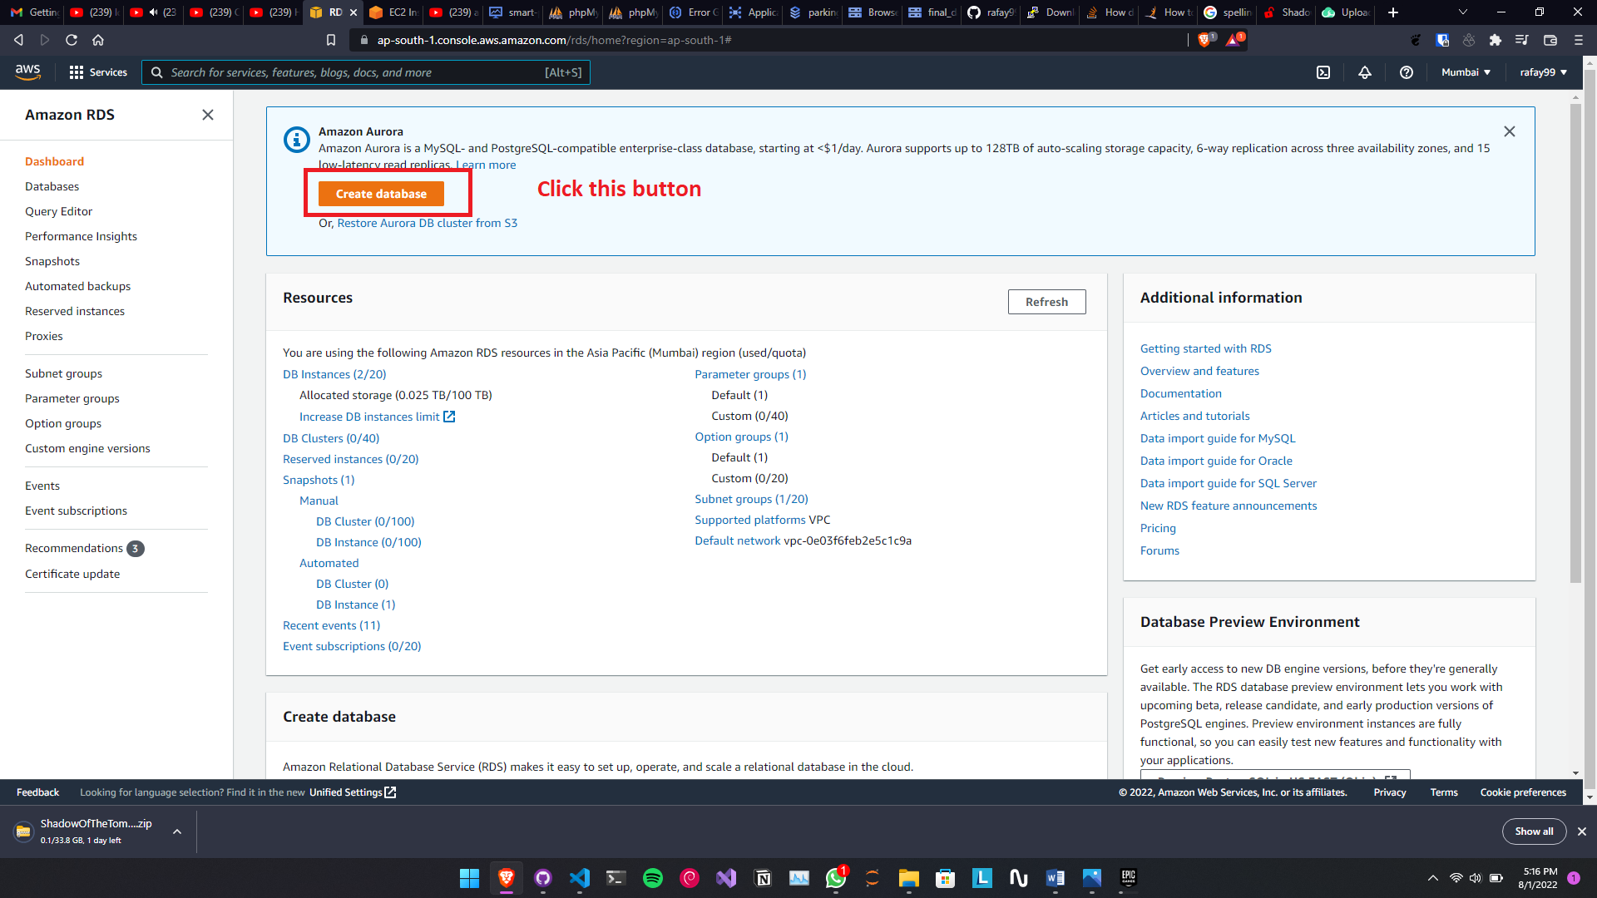
Deployment (Database)

Slide 19
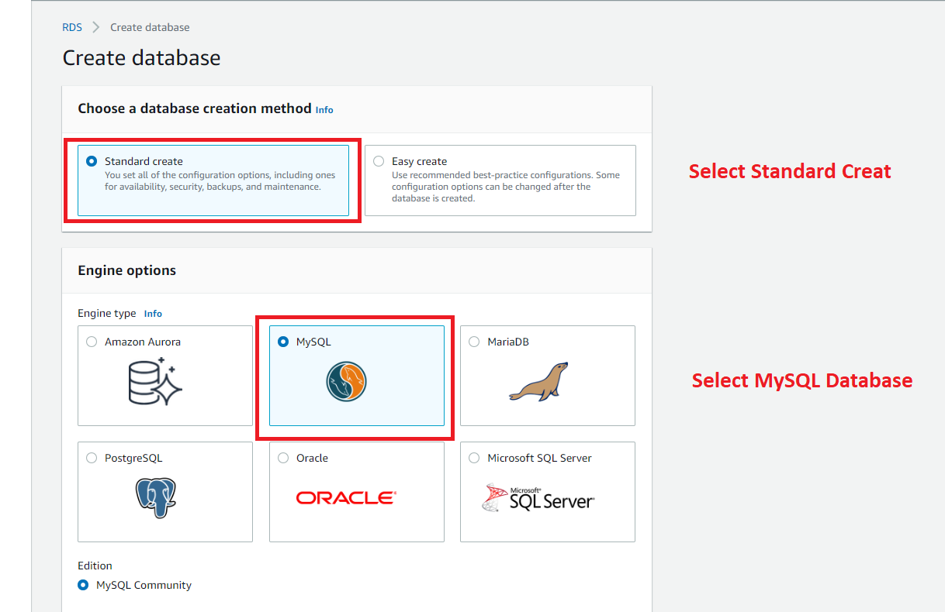
Deployment (Database)

Slide 20
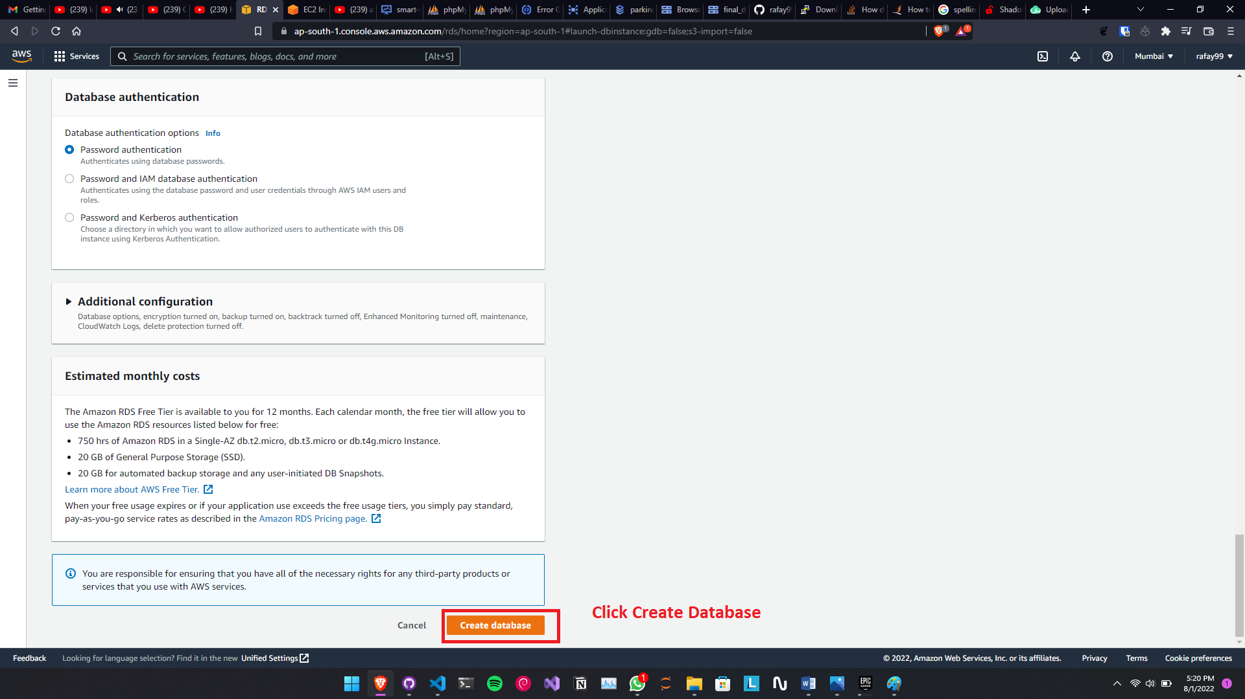
Deployment (Database)

Slide 21
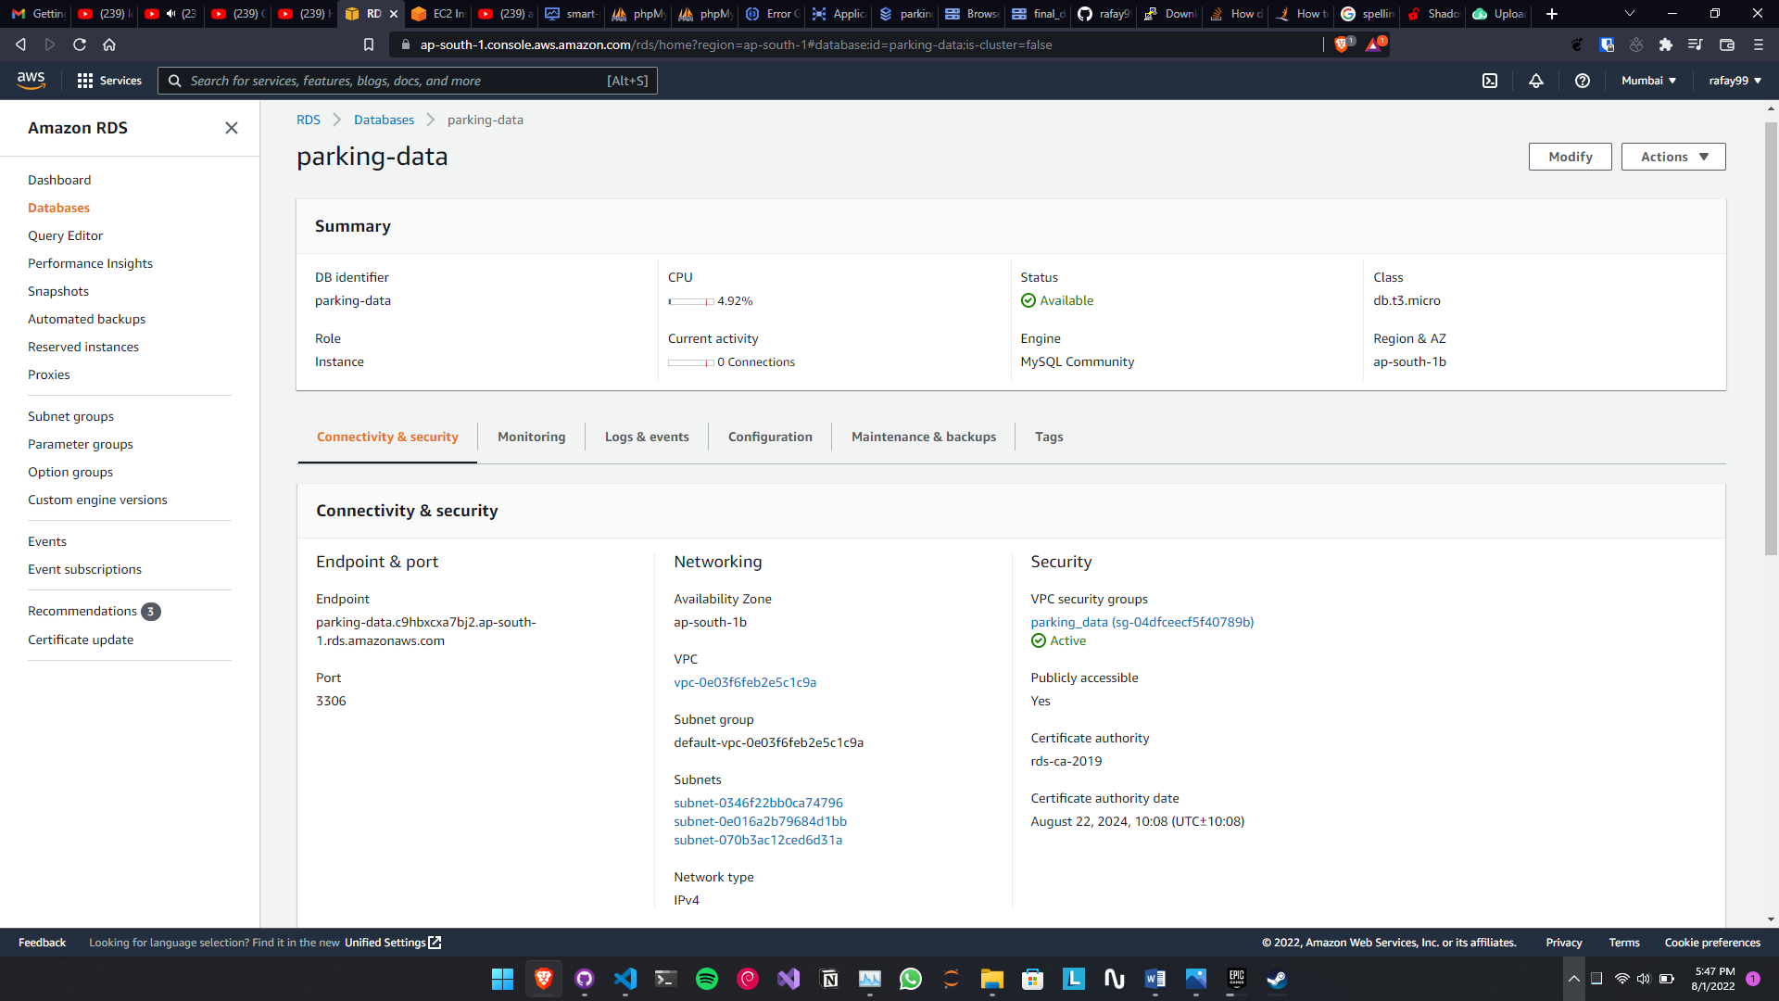
Deployment (Database)

Slide 22
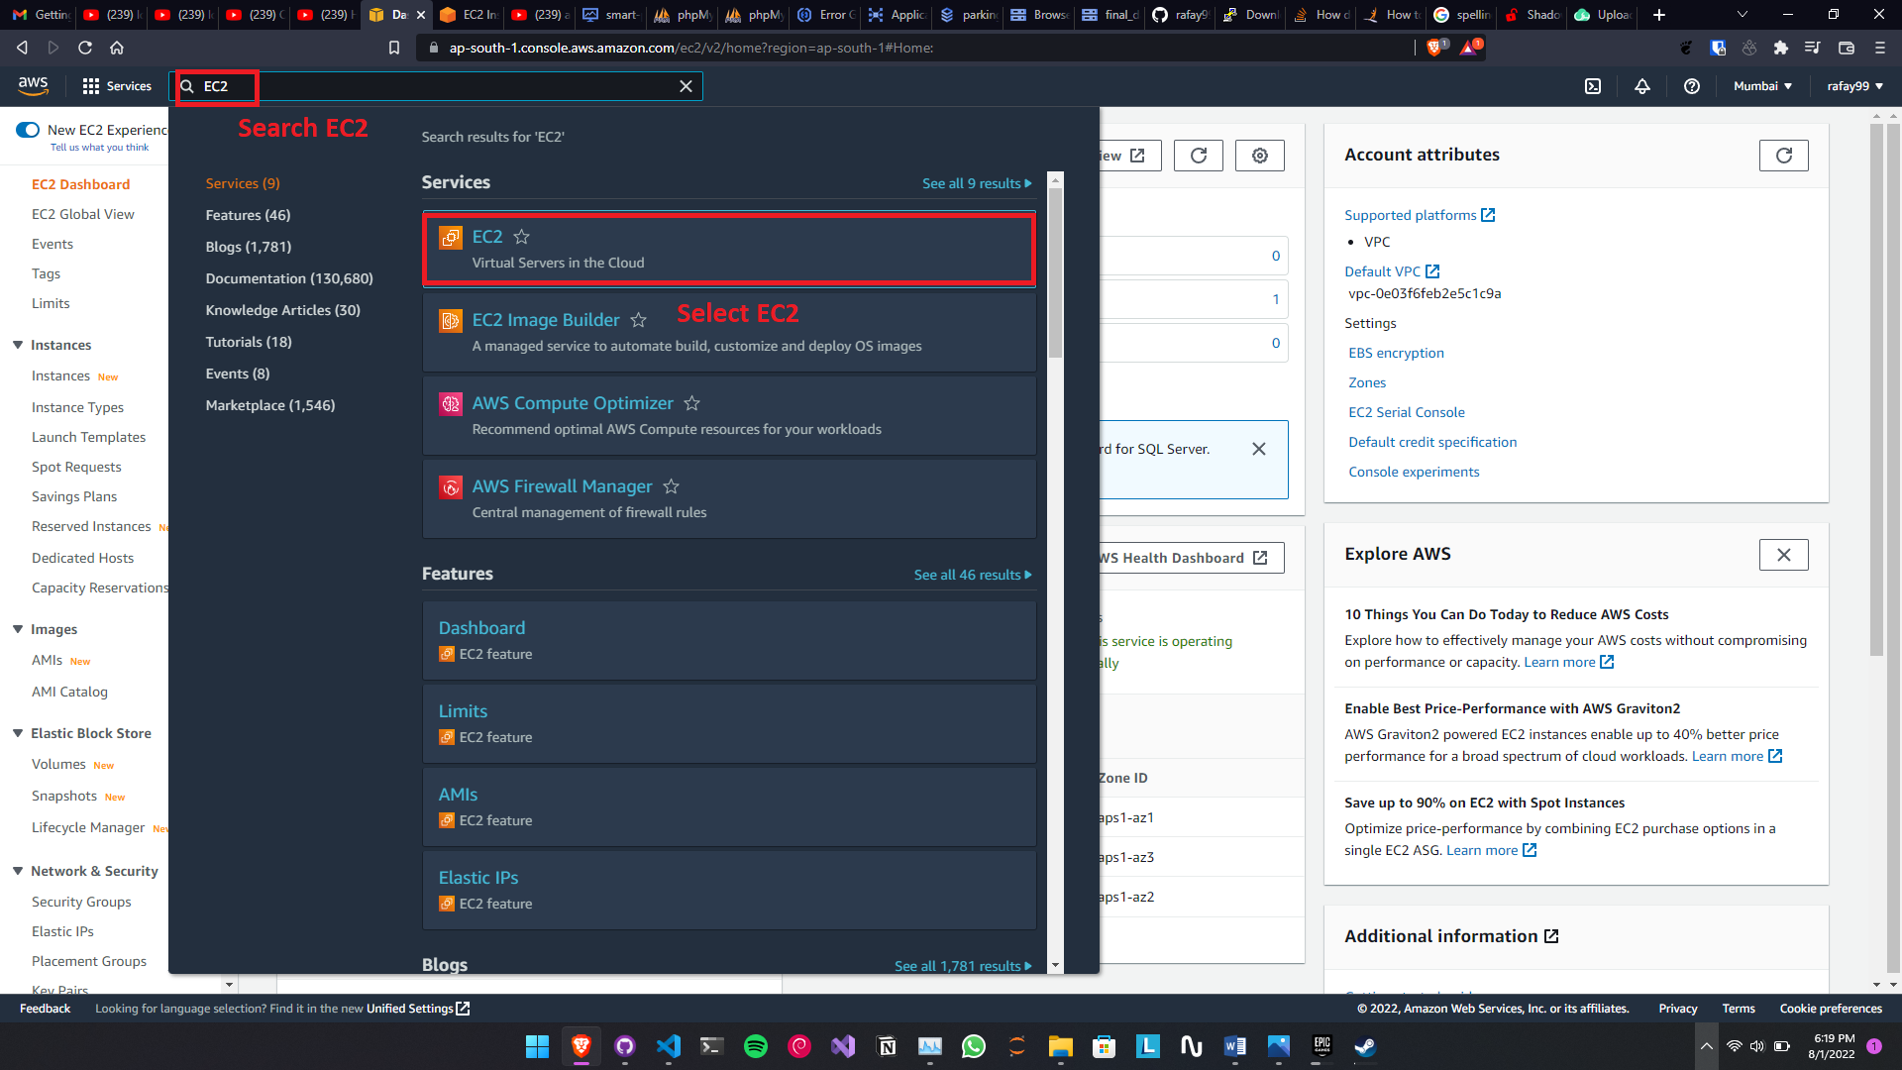
Deployment (WEBSITE)

Slide 23
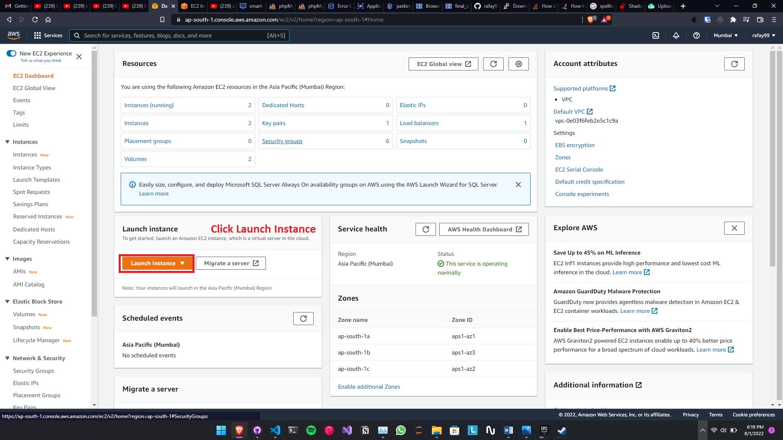
Deployment (WEBSITE)

Slide 24
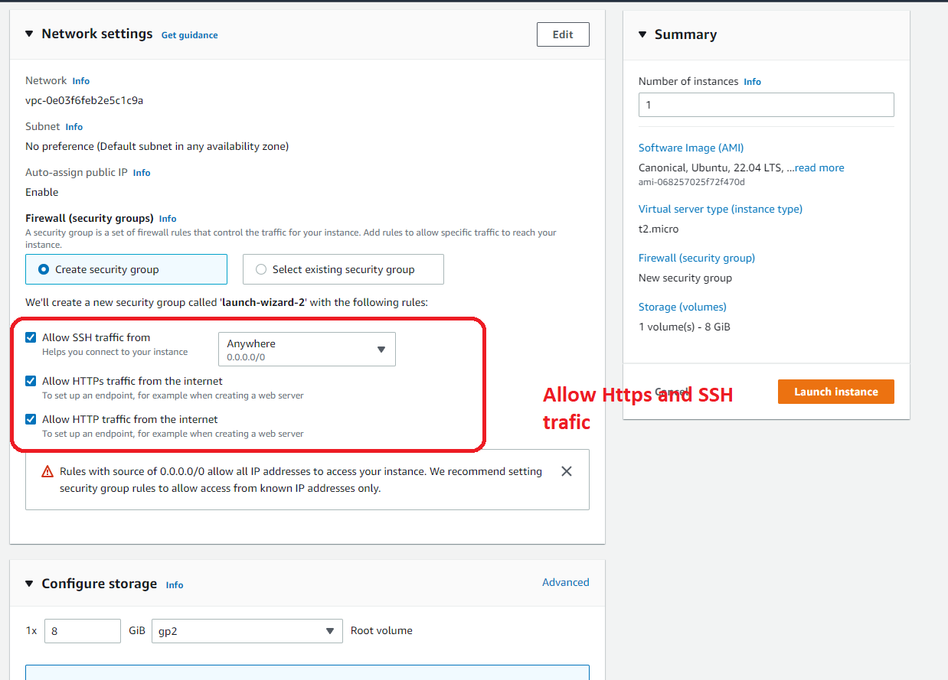
Deployment (WEBSITE)

Slide 25
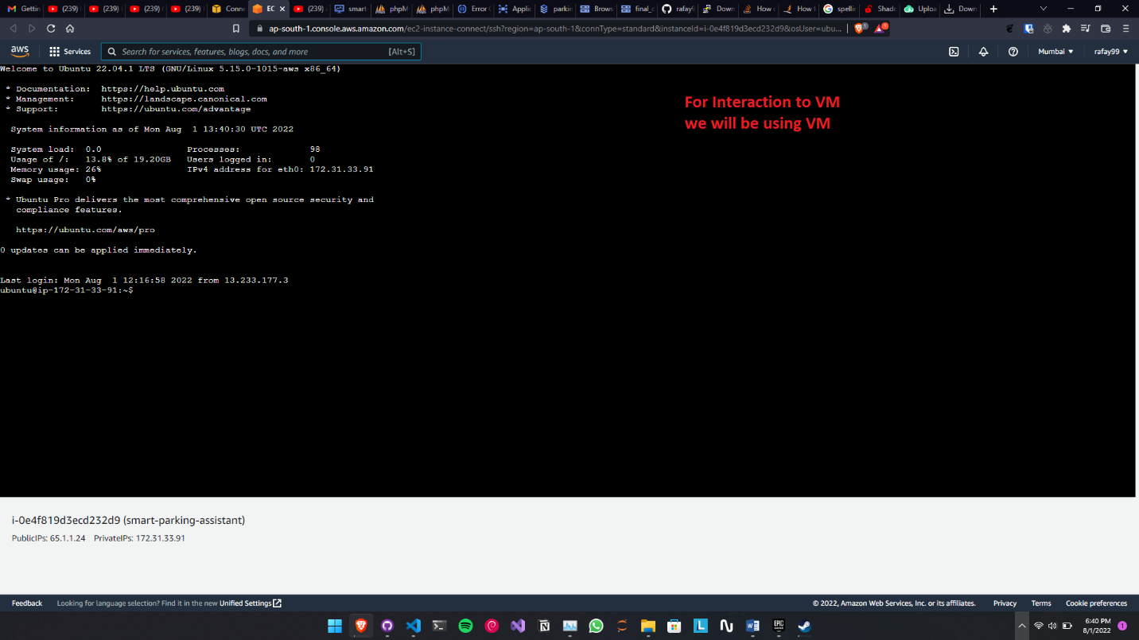
Deployment (WEBSITE)

Slide 26



THANK YOU
Saif Akhter
M.Abdul Rafay
+92 306 5180 464
+92 3035650797
Saif_Akhter@live.com
99marafay@gmail.com

